Slide 1

X-861 PRO- Introduction
SHENZHEN SMARTSAFE TECH CO., LTD.

Slide 2
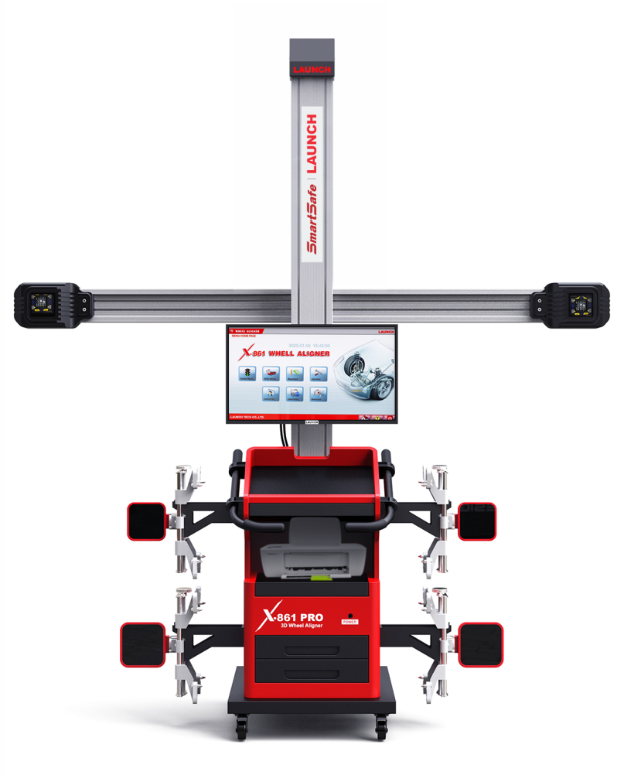
X-861 PRO is Ultra HD 3D wheel aligner, which is using 5G ultra-high speed camera and USB3.0 communication interface. It has the characteristics of high efficiency, high precision and high repeatability. It can automatically adjust the height of camera beam in keeping with the target height, so as to ensure the accuracy of measurement results and improve the user's operation experience.

Slide 3
Features
Extreme accurate, Extreme transmission, Extreme calibration.
Superfast transmission speed throughout 5Gbps bandwidth, and USB3.0 enables you to delivers the image fast.
Wide range of view on better performance 5MP camera, make it easy access to large cars.
Only need to move a small distance without stopping to perform accurate measurement during the dynamic measurement.
HD Camera lens with temperature compensation function, make it possible to at all times and in all conditions work.

Slide 4
Features
Be built for improving productivity by movable cabinet and beam.
Automatically adjust the height of camera beam in keeping with the target height.
Simpler alignment procedure with LED indicator and computer voices reminder.
Start to use in seconds, no more tedious work of pre-calibration.
Body & Chassis and tire diameter measurement,.
Broadest application with big scissor lift, four-post lift, small scissor list, two-post lift.

Slide 5
Measurement Parameters
Alignment Parameters | Measurement Range | Measurement Accuracy
Display Accuracy | 1’/0.01/0.1mm | /
Toe | ±40° | ±2’
Camber | ±10° | ±2’
Caster | ±20° | ±5’
Kingpin Inclination | ±20° | ±5’
Retraction angle | ±5° | ±2’
Trust angle | ±5° | ±2’
Wheel Track | 2000mm | ±2mm
Wheelbase | 4000mm | ±2mm

Slide 6
Accessories
 | Item | Amount
Standard Accessory | Cabinet | 1 pcs
 | Beam | 1 pcs
 | Post | 1 pcs
 | Clamp & Target | 1 set
 | Turn Tables | 1 pcs
 | Steering Wheel Holder | 1 pcs
 | Brake Holder | 1 pcs
Optional Accessory | Computer | 1 pcs
 | Keyboard & Mouse | 1 pcs
 | LED Display | 1 pcs
 | Printer | 1 pcs
Optional Tool Kit | Special took kit (38pcs) | 1 set

Slide 7
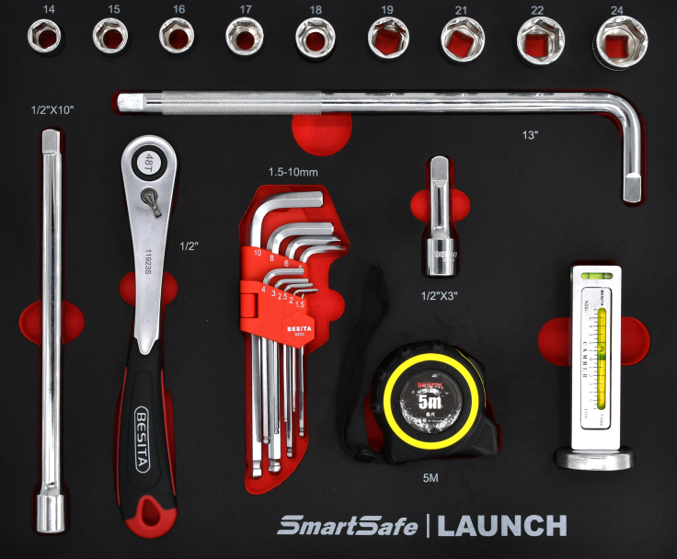
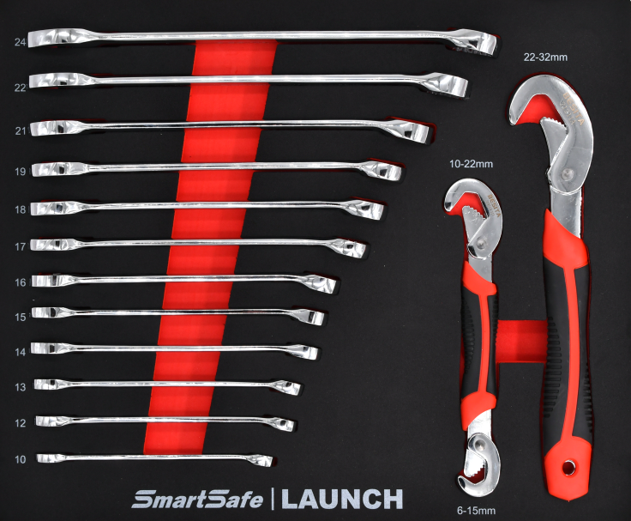
Special Tool Kit (Optional)

Slide 8
Main Functions
Standard Measurement
Finish one standard four-wheel positioning process set by the system, including selection of vehicle type, vehicle measurement, vehicle adjustment and user's data and printing function.
Quick Measurement
It can select some measurement functions individually, including four-wheel positioning, caster measurement, chassis parameters, and lifting adjusting.
Measurement Result
Display the measurement result, including fore-wheel positioning, rear adjust, front adjust.
Print
Show and print the reports.

Slide 9
System Management
Units Setting
The user can select proper detection unit according to the user’s habit and requirements of vehicle manufacturer.
Store Information
It used to set the store information , and they will be displayed in the report.
Language Setting
The user can select their preferred language, after the software is restarted, the prompt words appearing are just the one you set.
System Information
System information actually includes software version, aligner version, software ID, software KEY-CODE, production date, expiration date, valid days, aligner version upgrade code and administrator code.

Slide 10
System Management
CPC Calibration
It used for calibrating the camera relative position. CPC calibration has been made before the delivery of products so it becomes unnecessary on site.
CTC Calibration
It used for compensating the assembly tightness between fixture and target. The fixture may be certainly deviated in terms of mechanical coordination after being used for certain period.
System Detection
It used to detect the working state of camera during the system test process.
Automatic lifting
It used to set prior to the delivery of product, and control module is integrated in interface of the vision field of camera. Lifting has two modes, i.e. automatic and manual lifting.

Slide 11
Comparative Advantage VS X-861
The column is fixed on the cabinet, the whole can be moved, easy to share multiple stations.
5 megapixel high-definition camera, with broadly view, can meet the requirements of ultra-long and ultra-wide vehicles.
USB3.0 communication interface, transmission bandwidth up to 5.0Gbps, fast data display.
The push distance is less, and there is no pause.

Slide 12
Freight Dimensions
Beam Assembly:
2900mm*350mm*590mm
Weight 118Kg
Accessories:
600mm*660mm*1030mm
Weight 75Kg
Cabinet:
890*790*1340
Weight: 105Kg

Slide 13

Thanks!

